Slide 1



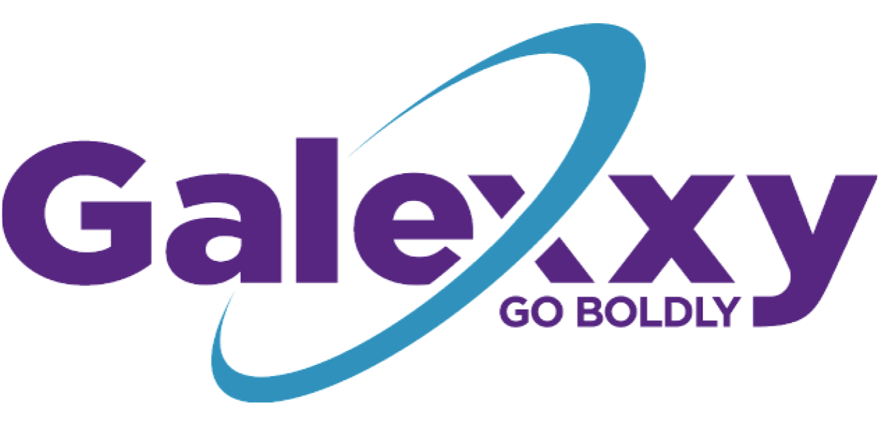

Innovation
in the Health
and Wellness Industry
A Vertically Integrated Holdings Company

Slide 2
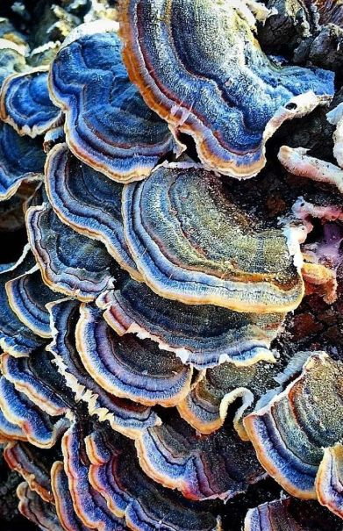
About Us
Galexxy Holdings, Inc. (The Company or GXXY) (OTC: GXXY)
stands at the forefront of innovation in the health and wellness industry.
Our commitment lies in harnessing the power of nature to create products that promote holistic well-being and contribute to a healthier, happier society. ​
​
Strategic Vision: The company’s mission is the vertically integrated leader in the Functional Mushroom ​products sector we call, “The 3,000 Year-Old-Secret to Health”. ​
​
The market is anticipated to be a $69 billion growth sector by 2030. By targeting the most common health concerns, this market intersection represents a much larger $13 Trillion projected global health market. ​
Manufacturing: The company has long term relationships with raw material and manufacturing partners with exceptional capacity to produce large quality volumes.
​
The Science: The scientific process provides an incredible competitive advantage in the marketplace with 4x potency and efficacy results that are off the charts through triple extraction. ​
​
Farming Operations: GXXY has US farming relationships through the extraction company and has secured long term sourcing agreements.

Slide 3
Clean, Potent, and Effective
Setting a new standard for Nootropics
Our Story
Bringing Mushrooms to the Light and Creating an entirely new ecosystem of opportunities
Potency – The Science - Triple Extracted, 100-day process, pure with no dilution, full body & mycelium
Adaptogens, and more specifically nootropics (brain fuel) like functional mushrooms can have amazing benefits in your daily life. These crucial ingredients and benefits can radically transform lives if the benefits are more mainstream, better understood, and accessible to many more people. This is a category creator opportunity for Galexxy.
Our team owns important assets to create that category. We have a proprietary and unique triple extraction solution. It provides up to 4x the potency and purity of our products, not only uncommon but mostly unavailable in the current market. By combining our proprietary adaptogen formulations with clinically proven functional mushrooms, we have isolated a winning suite of products that get results.
In the nootropic space, wellness is defined as not just physiological change, but feeling and experiencing the results in our ability to focus, apply our energy, engage, and meet every moment to be our best.
Join us to feel the many benefits our products can have for meeting your best moments.
USA Organic – Organic mushrooms from farms built on trust
Clean – No added corn syrup, cane sugars, artificial colors, or artificial additives
Adaptogen Blends – Researched nootropics combined with adaptogens with synergistic benefits
Accessible – Delivered quickly, convenient packaging, ability to scale to the world

Slide 4
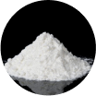
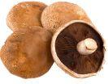
Science Meets Nature
Galexxy addresses the stress cycle to allow every person to better meet the moment.
We’ve created a brand combining nootropics and adaptogens through a new extraction science, with full-spectrum benefits, and high-quality products that are simple and get results.
Creating a new brand combining high quality adaptogens and nootropics:
bringing Galexxy to the masses
Standard in the Market: Watered-down gummies made from cheap powders from China. Look at their back label with 10:1 or even 20:1 dilution vs Galexxy’s pure 1:1 product liquid extract, added corn syrup, and un-natural ingredients.
Galexxy Product Differentiators
Exclusive proprietary 100-day Triple Extraction Process
(hot water/
glycerine/100-day fermentation)
4x Potency – 1:1
vs. powders water/alcohol and the majority of other products diluted 10:1 or 20:1
Contains the Fruiting Body and Mycelium
More bioavailable
Rich in pre and probiotics with compounds not found in just the fruiting body.
Others use only the fruiting body
USA
Manufacturing
Fully vertically integrated and controlled ingredient inputs from farm to final production, all USA Sourced and Manufactured
USDA-Certified Organic
Trusted farming operations with decades of experience producing fully organic products

Slide 5
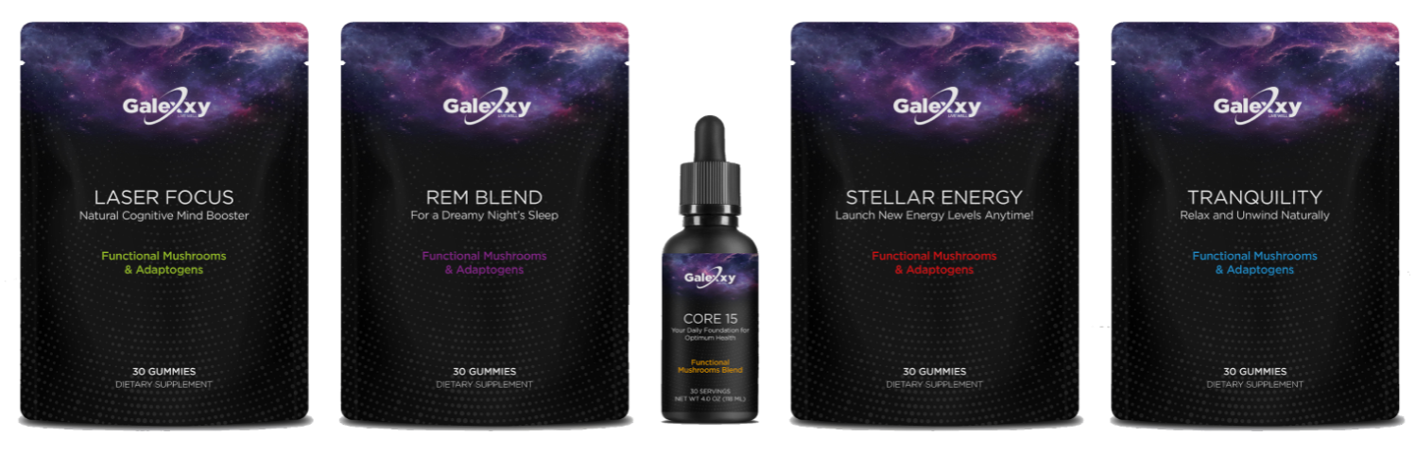
Blended Adaptogens - A New Natural Product Nootropic Category
By combining a proprietary 100-day extraction process, studied formulation blends combining nootropics with adaptogens from functional mushrooms, we’ve magnified the benefits of these ancient healing wonders.
Our Competitive Advantage
Clean. Connected. Powerful.
There are clean, safe, and powerful solutions found in 3000-year-old ingredients that provide new answers to living in the present
Galexxy – Lightyears Ahead of Competitors
Let us help you bear the load. Galexxy’s functional mushroom blends combining powerful nootropics and adaptogens help you meet the moment adapting to your situation for increased focus, better sleep, and richer experiences ahead
“The be rested gummies are like a lullaby for the soul.”
Emma Anderson

Slide 6
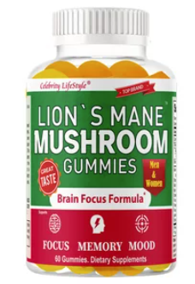
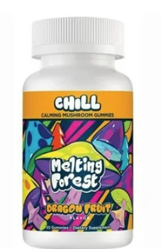
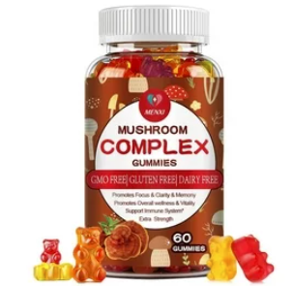
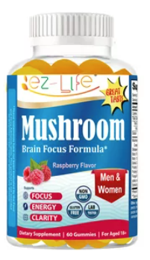
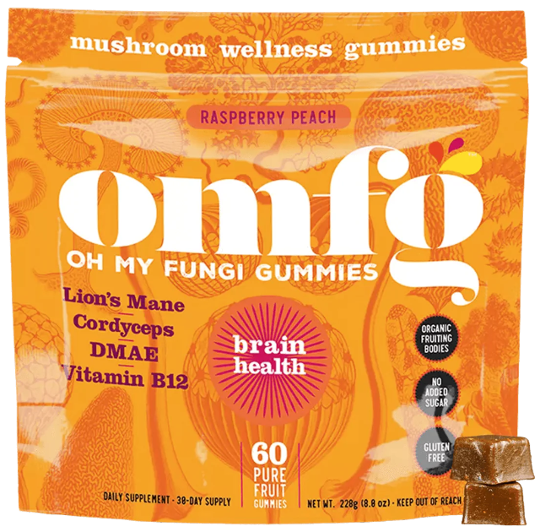
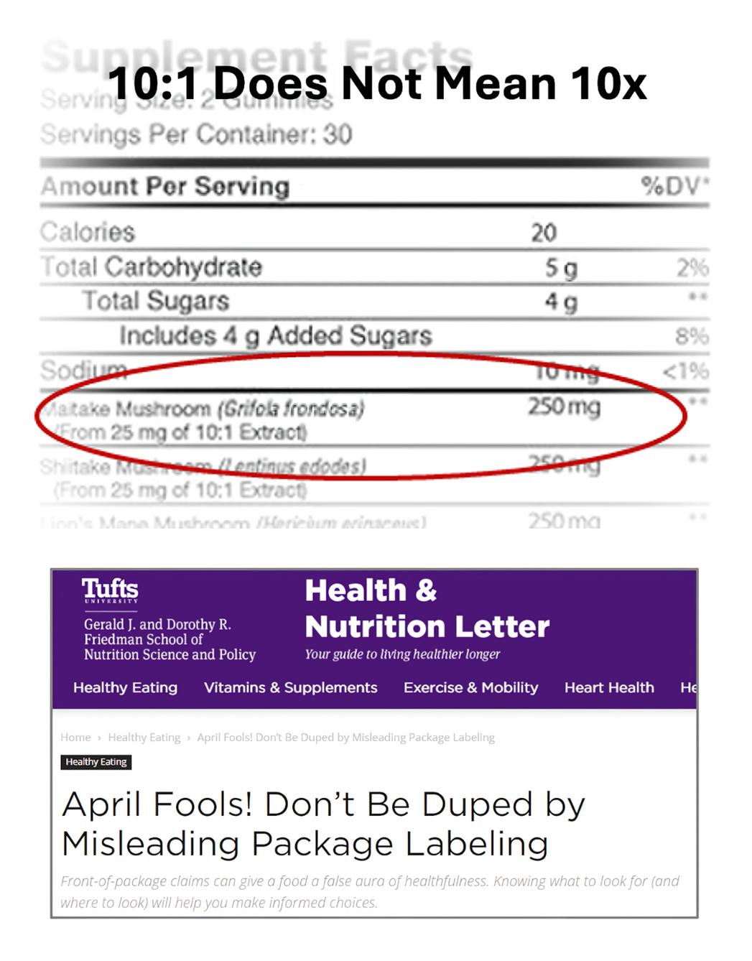
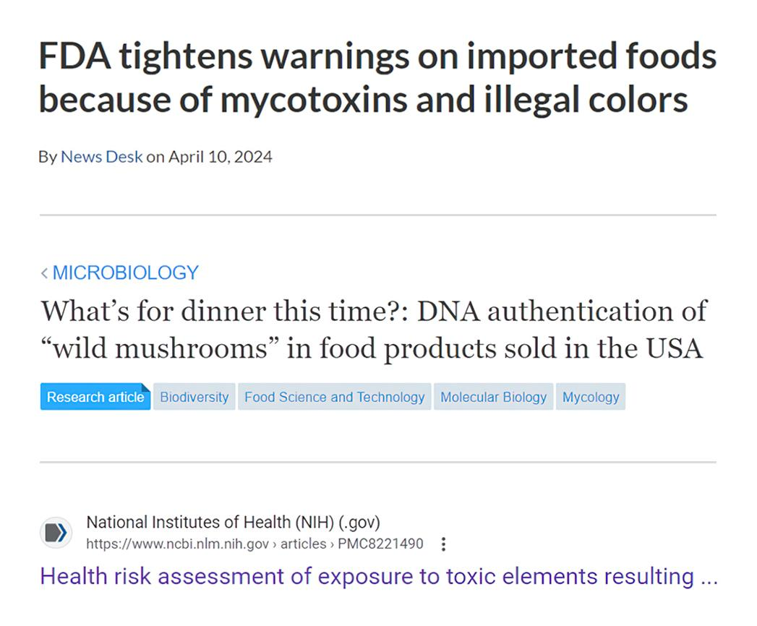
The Industry is “emerging” and is not quality-focused
The opportunity is to create a new brand in this category with new standards.
The highest quality products
Products backed by science
3rd party tested and validated
Clean and transparent
Current Brands Available Not Attractive
Lack of Transparency in Labeling
Little Validation or 3rd Party Testing

Slide 7
We need new health solutions for coping as well as a new financial opportunity
Why Functional Mushrooms?
Asian Cultures have used them for centuries​
New Clinical Studies are proving their health benefits​
New extraction techniques are unlocking their true powers​
*The majority of Gen Z and millennials are stressed, have anxiety, and are “consumed” by their worries about money. “
Functional mushrooms have gained significant attention for their remarkable health benefits. Mushrooms, such as Reishi, Chaga, and Lion's Mane, contain a rich array of bioactive compounds that contribute to positive benefits on human well-being. ​
Adaptogenic Properties. Support the body to adapt to stressors and maintain balance. This adaptability can contribute to better stress management, improved energy levels, and overall resilience. Functional mushrooms offer a holistic approach to health, addressing multiple facets of well-being and providing a natural and sustainable option for those seeking to enhance their vitality.
​Immune Support. Compounds like Beta-glucans found in these mushrooms play a crucial role in enhancing the immune system's response, helping the body defend against infections and illnesses.​
Cognitive health and mental well-being. Lion's Mane is renowned for its potential to support brain function. Research suggests that compounds in this mushroom may stimulate the growth of nerve cells and promote cognitive function, memory, and focus. ​
Sleep. Reishi has been shown to promote sleep and deeper restful sleep. ​
Energy. Cordyceps has been shown to fight inflammatory factors and to provide new energy and stamina. ​
68% experience anxiety
67% are “Consumed” by $ worries
73% hide stress from family
82% are worried about their health
81% cope with alcohol, drugs, OTC, Rx
40% are chronically tired
*Stress in America 2023

Slide 8
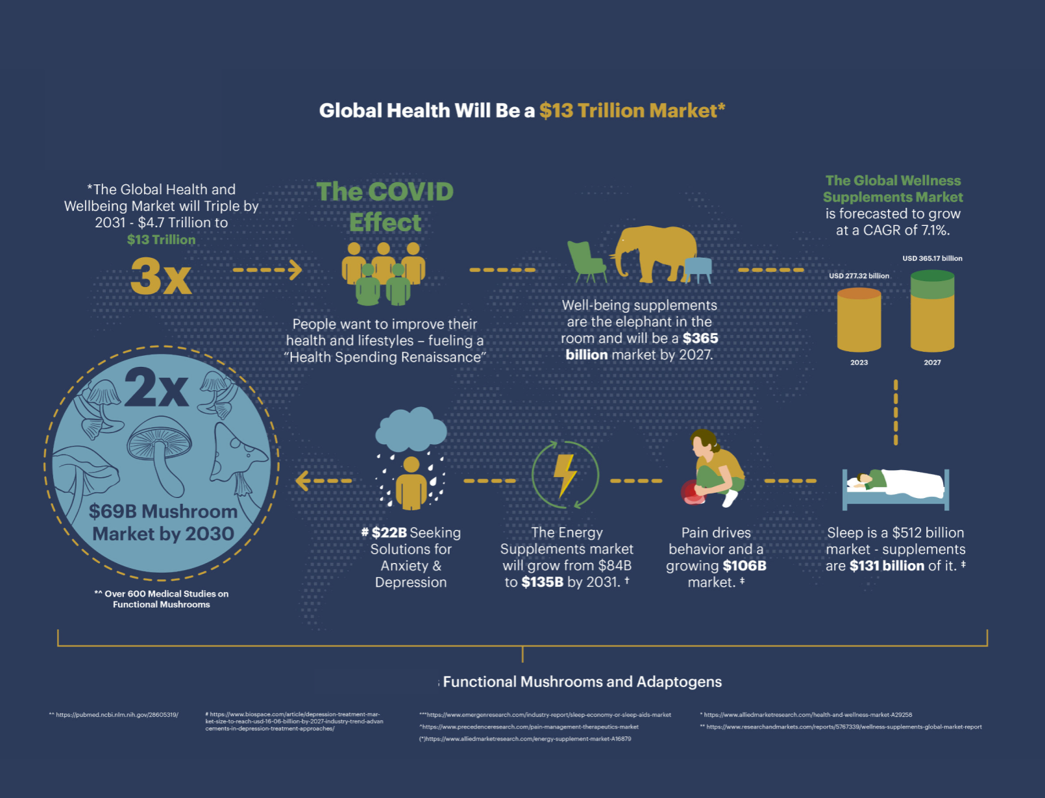
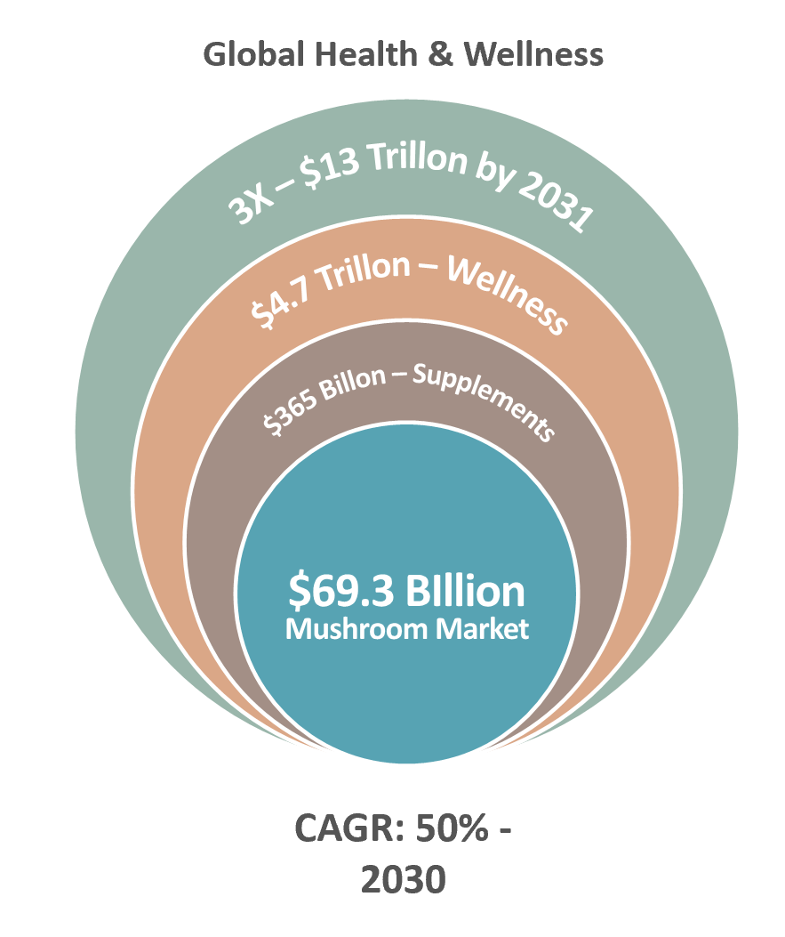
The size of the opportunity is massive

